Slide 1
Unsupervised Learning (Customer Segmentation)
Done By: Toh Kien Yu (P2222291)
Background:
Customer Segmentation is the process to group customers who share the same characteristics in order to understand the customer's spending behavior and is an important to effectively market to a specific target audience . This will allow the shopping mall to personalize marketing to specific groups and boost profability. We can group customers based on factors such as gender, age, income, amount spent and their interests

Slide 2
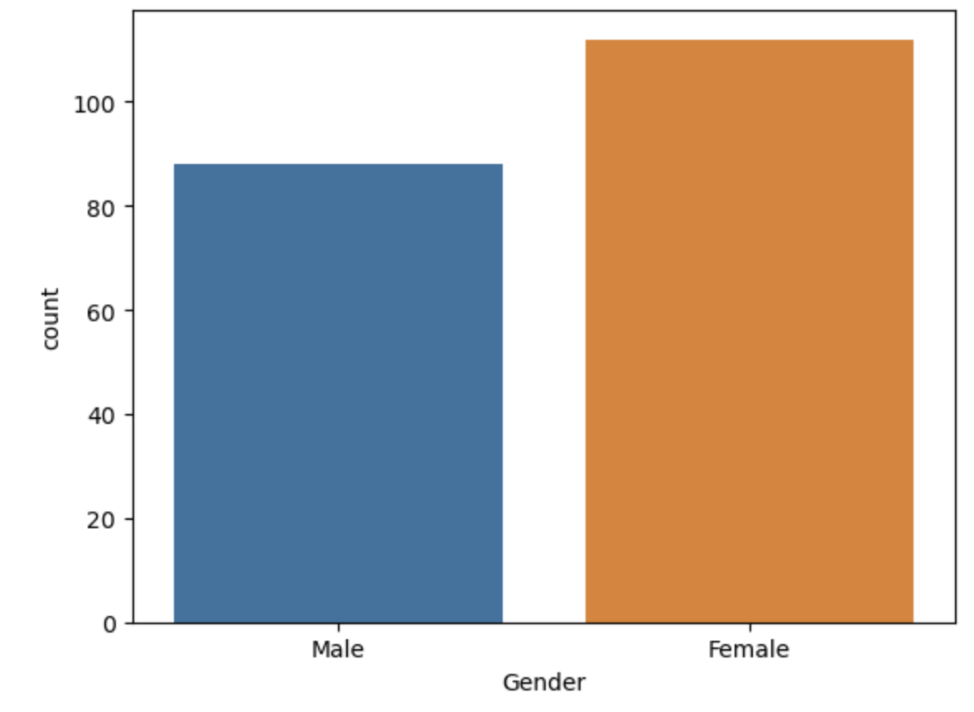
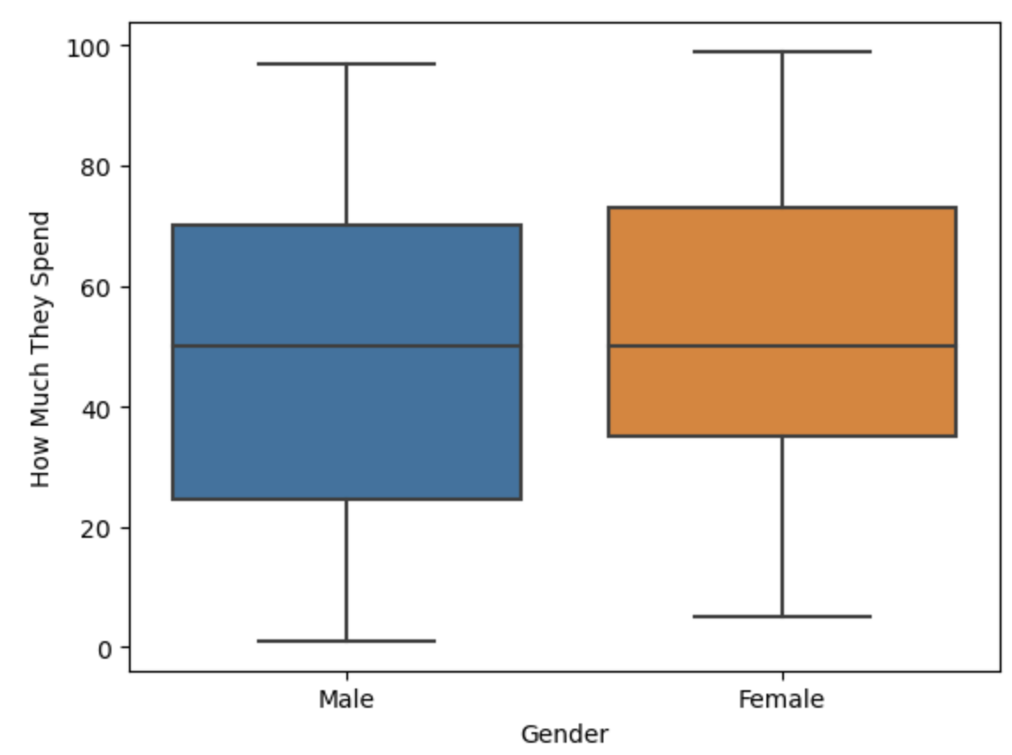
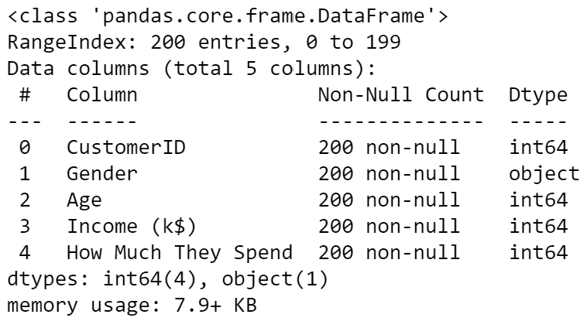
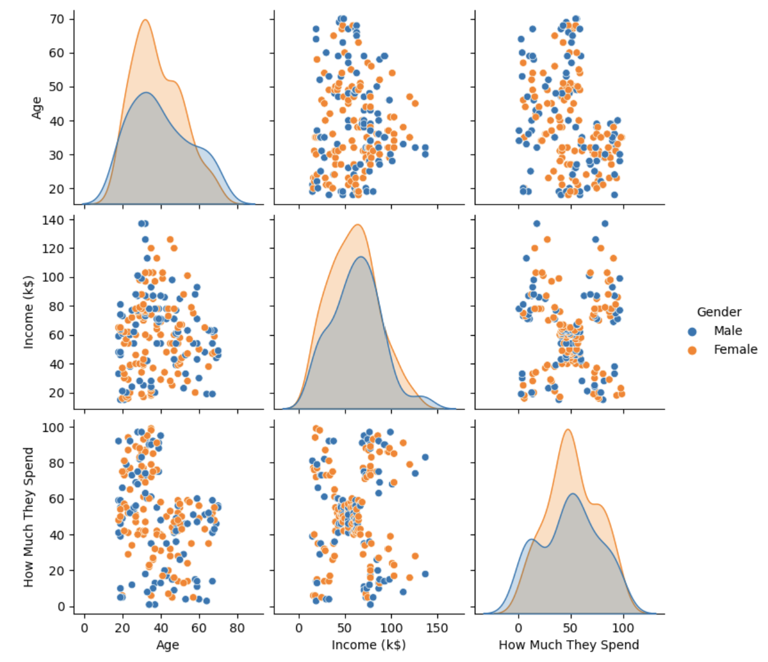

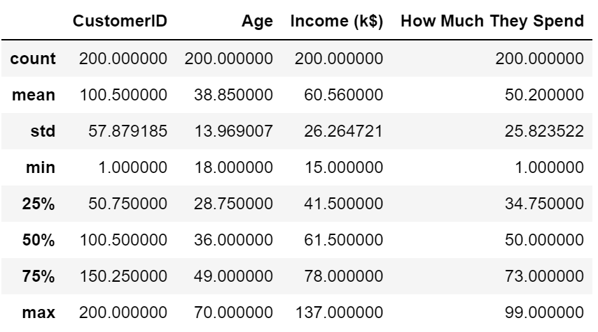
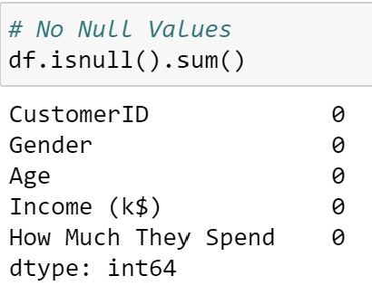
Nature of Dataset
Data Exploration
Categorical Data
Gender
Numeric Data
CustomerID
Age
Income (k$)
How Much They Spend
There are more females than males in the dataset
Median of how much a male and female spent is about the same.
From the pair plot, gender does not seem to have any correlation to age, income and how much they spend.

Slide 3
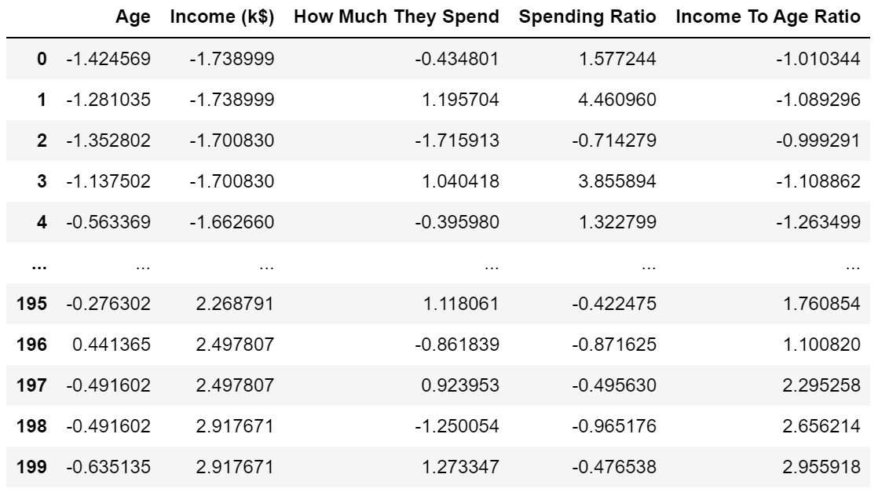
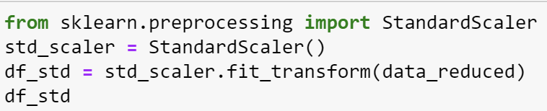
Data Preprocessing
Feature engineer is the process to create additional relevant features from the existing raw features of the data to improve the learning algorithm.
‘Spending Ratio’ is created to find out how much an individual is willing to allocate their income to spending.
‘Income To Age Ratio’ is created to find out the relationship between one’s different age group’s income.
Feature Selection is done to get rid of features that are redundant by taking the best subset of the dataset.
‘CustomerID’ is dropped as it is an identifying column and ‘Gender’ is dropped as there is no correlation to other variables.
Data is then standardized to so that the features are centred around 0 with a standard deviation of 1.

Slide 4
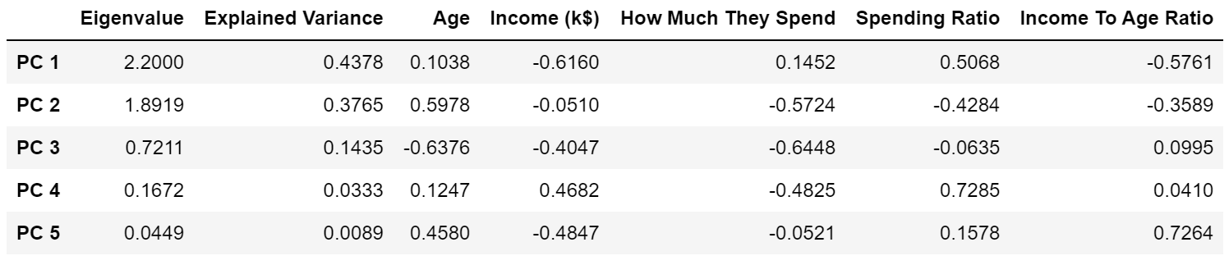
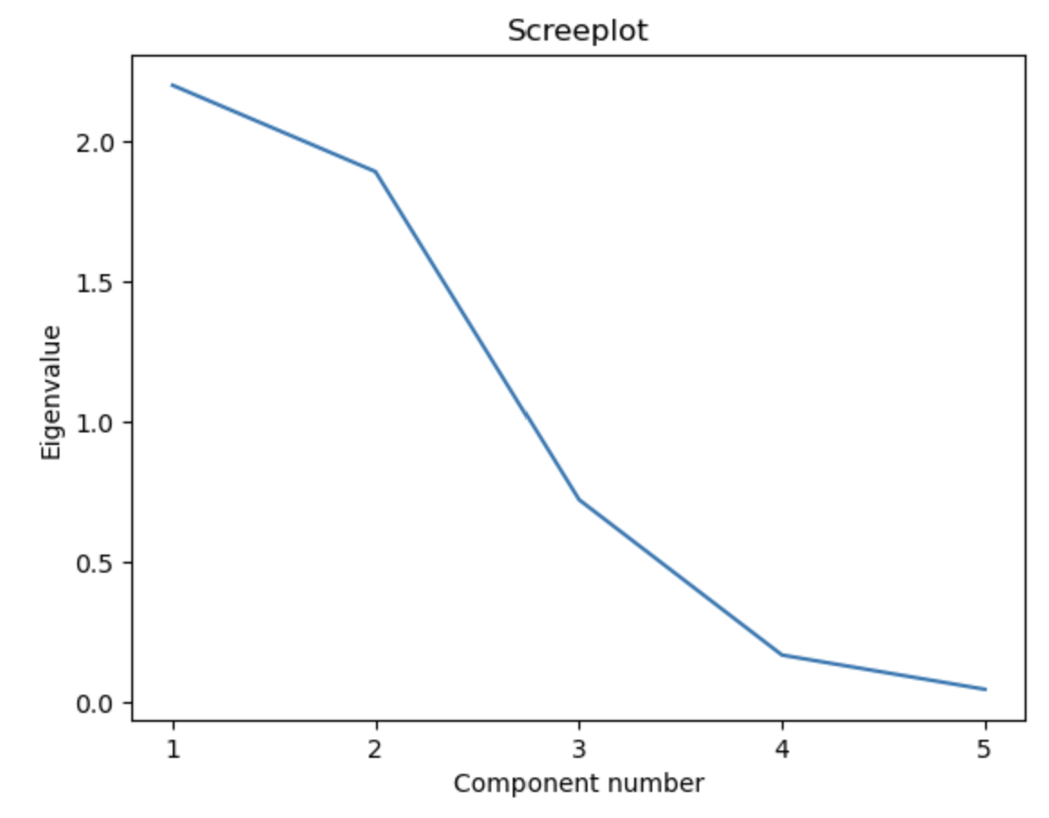
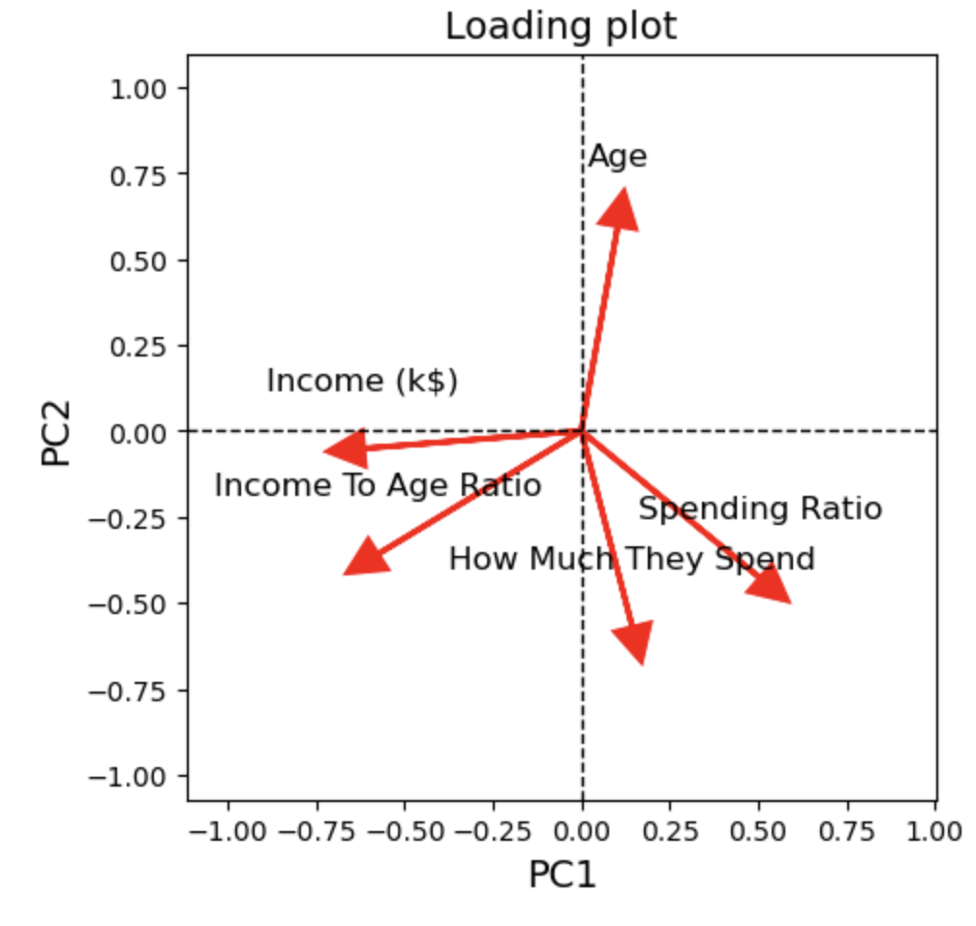
Dimension Reduction
Principal Component Analysis (PCA) is then performed to turn the data into a lower dimensional space while retaining as much information as possible
By Kaiser’s rule, extract the first 2 PCs where eigenvalues (2.2000, 1.8919) are > 1.
First 2 PCs accounted for 81.43% of the total variance.
Scree plot shows elbow at PC3 suggesting 1st 2 PCs to extract
Hence, lets extract 2 PCs.
Loading Plot allows us to visualize how each variable influences PC1 and PC2

Slide 5
Dimension Reduction
The loading on Age, How Much They Spend and Spending Ratio is opposite in sign to the other loading This PC seems to measure a contrast of Age, How Much They Spend and Spending Ratio against the remaining variables
Income has the highest negative loading of -0.6160 which tells us that low-income customers will score high on PC1, and high-income customers will score low in PC1.
Income To Age Ratio has a second highest negative loading of -0.5761 which tells us that customers with a low Income To Age Ratio score high in PC1.
Spending Ratio has the highest positive loading of 0.5068 which tells us that customers with high Spending Ratio will score high on PC1
PC1 mainly captures customer income levels and spending. A customer with low income and high spending ratio will score high on PC1.
The loading on Age is opposite in sign to the other loading This PC seems to measure a contrast of Age against the remaining variables.
Age has the highest positive loading of 0.5978 which tells us that older customers will score high on PC2.
How Much They Spend has the highest negative loading of -0.5724 which tells us that customers with a low spending will score high in PC2.
Customers with a high spending ratio will score low on PC2
PC2 mainly captures customer age-related spending patterns. A customer who is older and has low spending will score high in PC2.

Slide 6
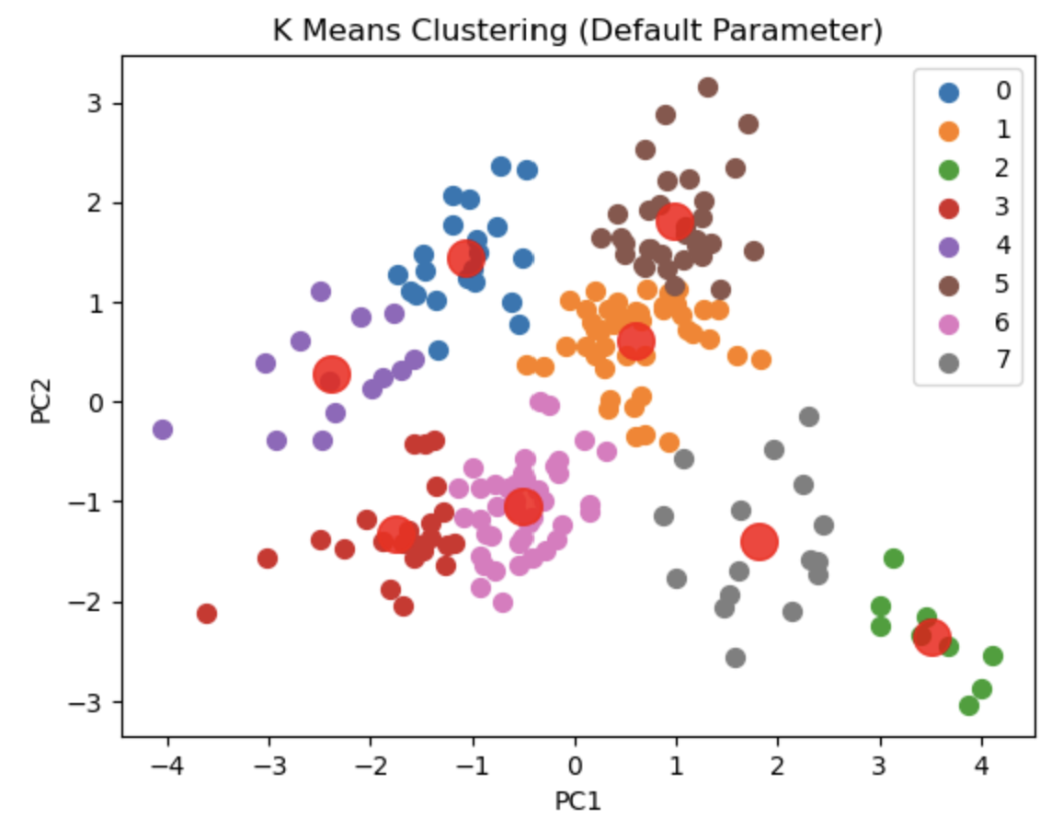
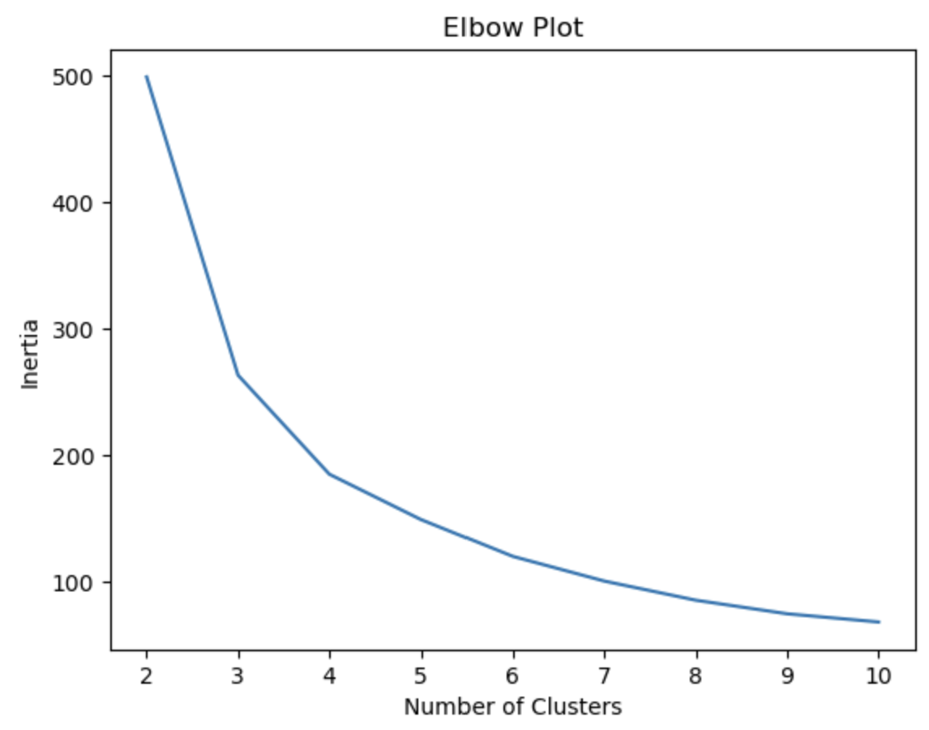
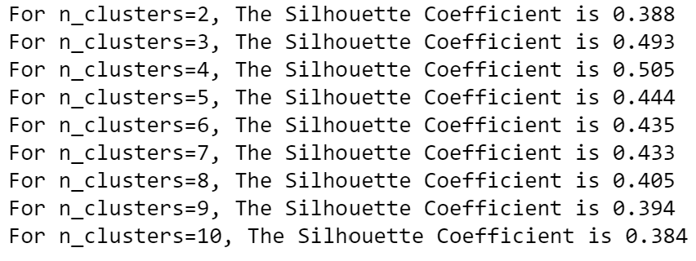
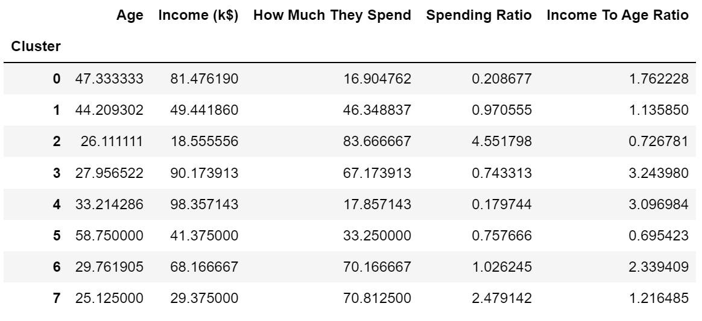
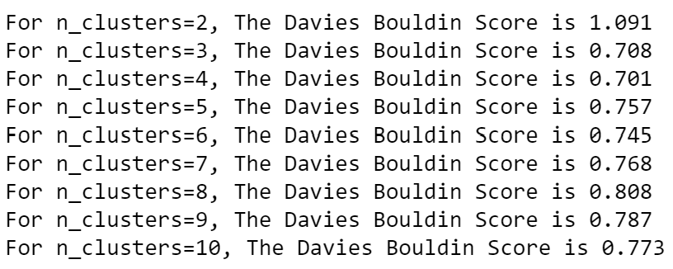
Modelling: K Means Clustering (Before Tuning)
The default parameters for K Means Clustering groups customers into 8 clusters. Cluster 2 and 7 depicts young customers who spends a lot but have low income. Although Cluster 2 has a higher spending ratio than Cluster 7, Cluster 7 has a higher income than Cluster 2 Cluster 3 and 6 shows young customers who spends a lot but have a high income. Cluster 3 has a higher income than Cluster 6 Cluster 1 and 5 represents older customers with average income and moderate spending. Cluster 5 made up of senior citizens and Cluster 1 is made up of working adults Cluster 4 and 0 are customers with very high income and low spending. Cluster 0 is made up of older individuals compared to Cluster 4
We will choose N Cluster = 4 as,
It has the highest silhouette coefficient of 0.505.
The elbow plots show an elbow at 5, which suggests to choose N Cluster = 4
Davies Bound-in Score is the lowest at N Cluster = 4
Customer’s Profile for different clusters

Slide 7
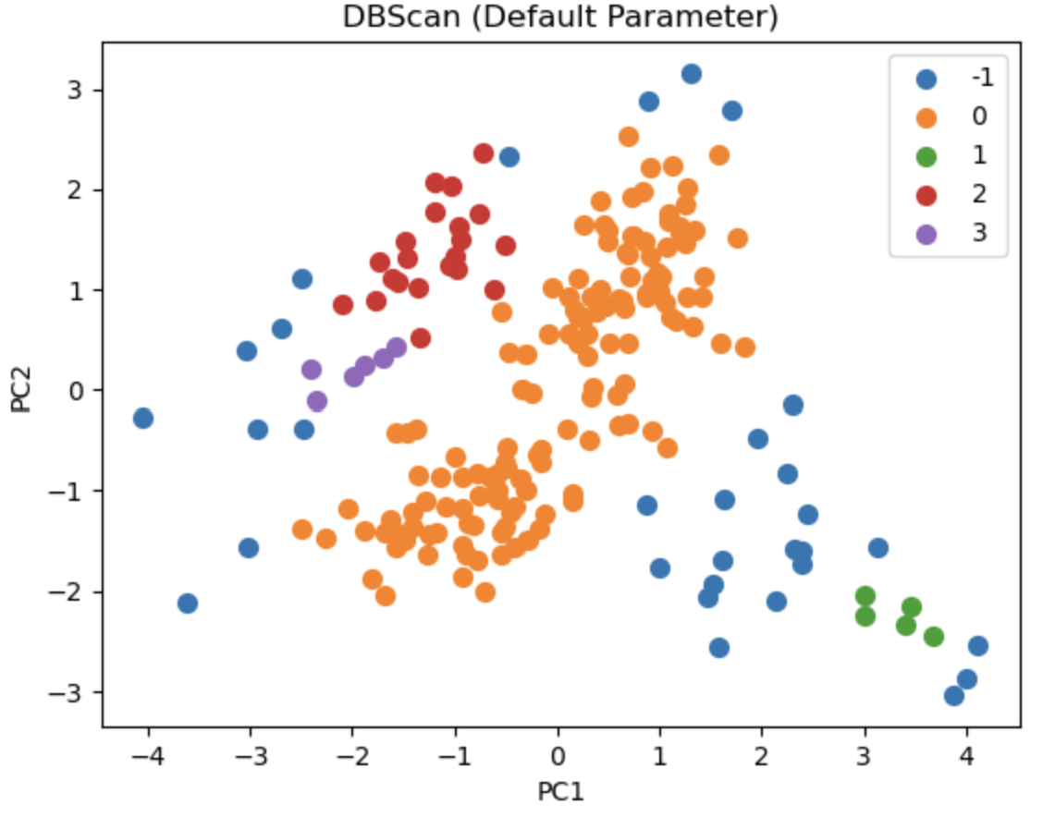
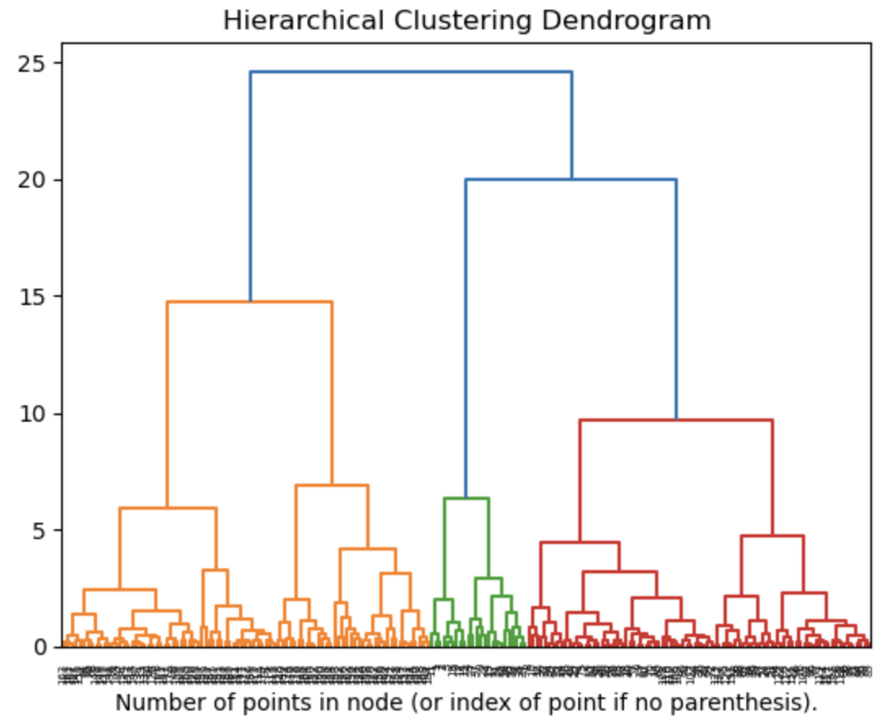
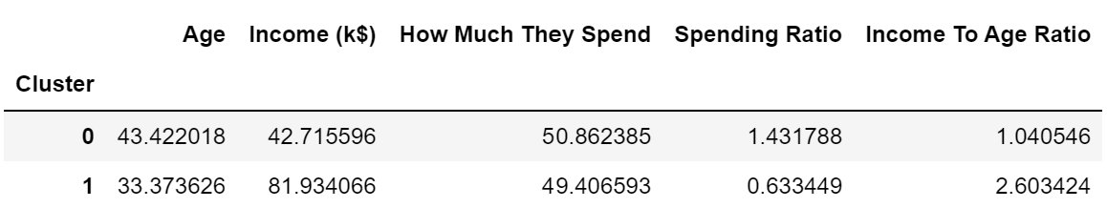
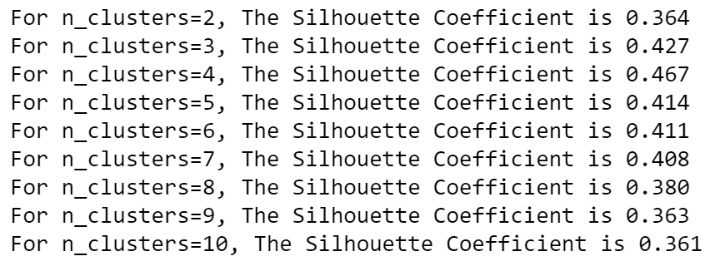
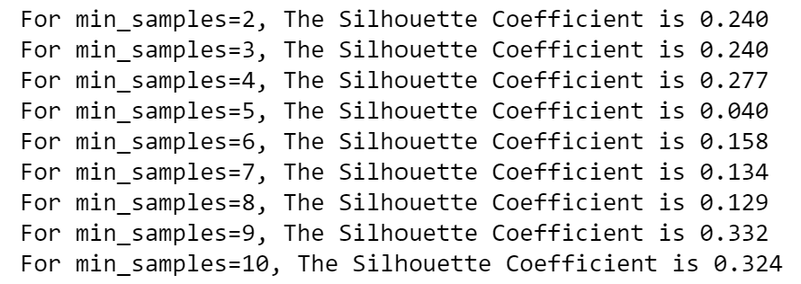
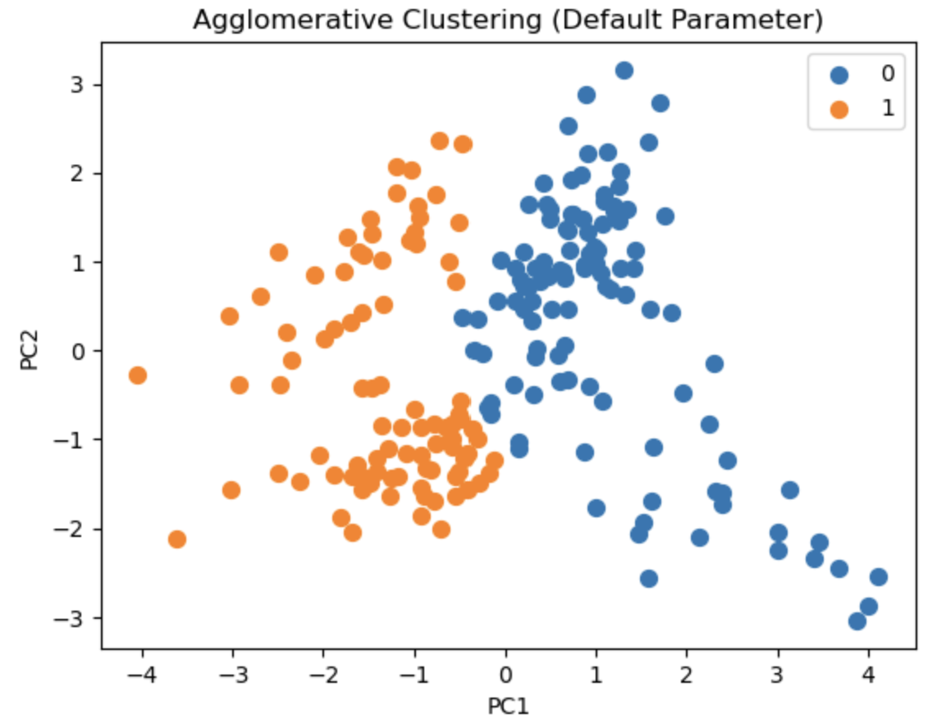
Modelling: DBScan and Hierarchical Clustering (Before Tuning)
DBScan
Hierarchical Clustering (Agglomerative Clustering)
Agglomerative Clustering’s Customer Profile
Customers in Cluster 0 have low income and high spending ratio
Customers in Cluster 1 have high income and low spending ratio
4 Clusters are produced, upon cutting a straight line at 10 on the Dendogram.
We will choose N Cluster = 4 as it has the highest silhouette coefficient of 0.467
Highest silhouette score is only 0.332 which is not very high.
Hence, DBScan is not effective for customer segmentation due to the dataset having large difference of density

Slide 8
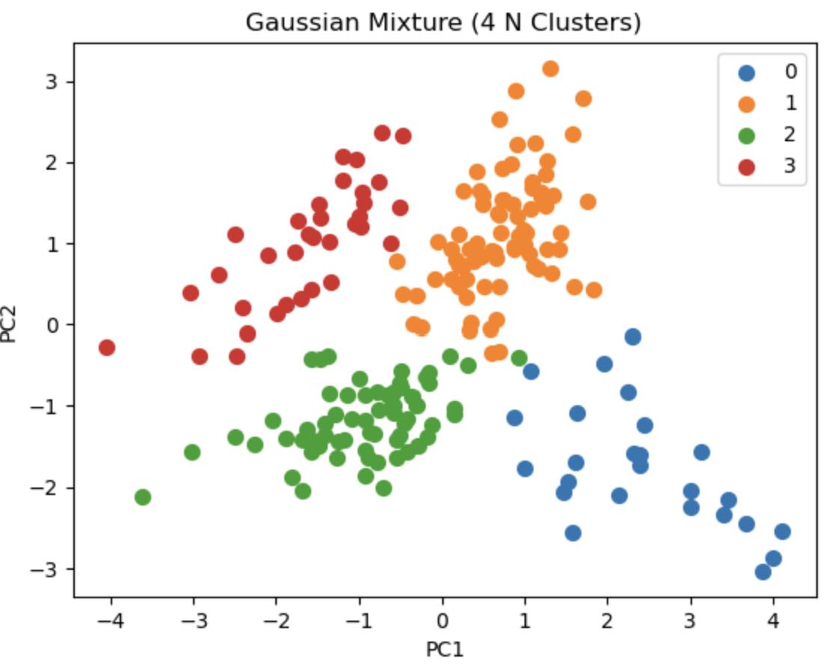
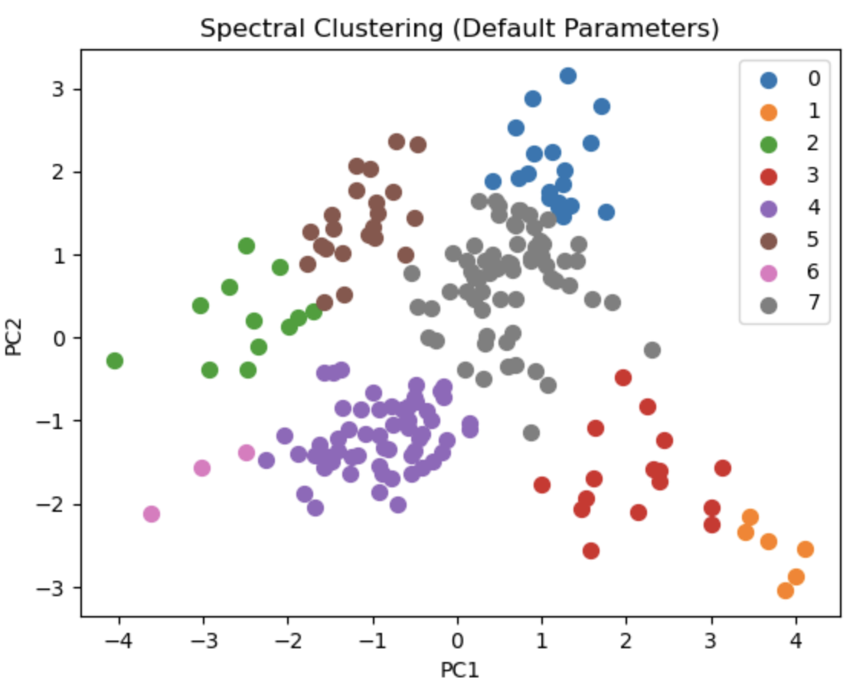
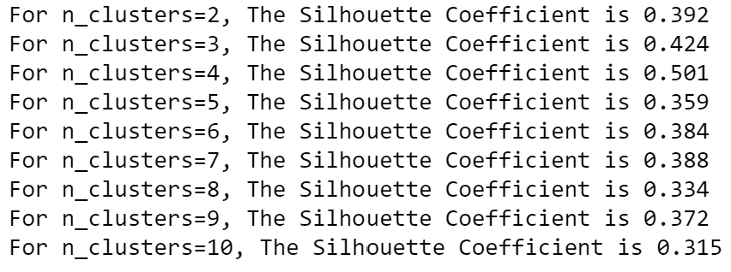
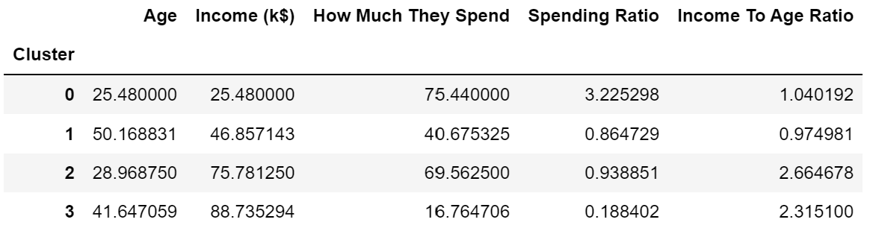
Modelling: Gaussian Mixture Model (After Tuned)
As the default parameter for N Cluster for Gaussian Mixture is 1. There is not much insights for default parameters. We will look at Gaussian Mixture with 4 N Clusters since it has the highest silhouette coefficient of 0.501.
Cluster 0: Young And Undisciplined Customers. Despite, these customers having a low income, they are big spenders and have the highest spending ratio. Cluster 1: Senior Citizens. These customer have moderate spending and have average income. Cluster 2: Young and High-Income Customers. These customers are from the above average income group and have a high spending. Cluster 3: Middle-Aged Citizens and High Income. These customers have a low spending ratio despite having a high income. They are financially stable and knows how to budget well.
I have also looked at Spectral Clustering but decided not to use it as it is quite sensitive to noise and outliers.

Slide 9
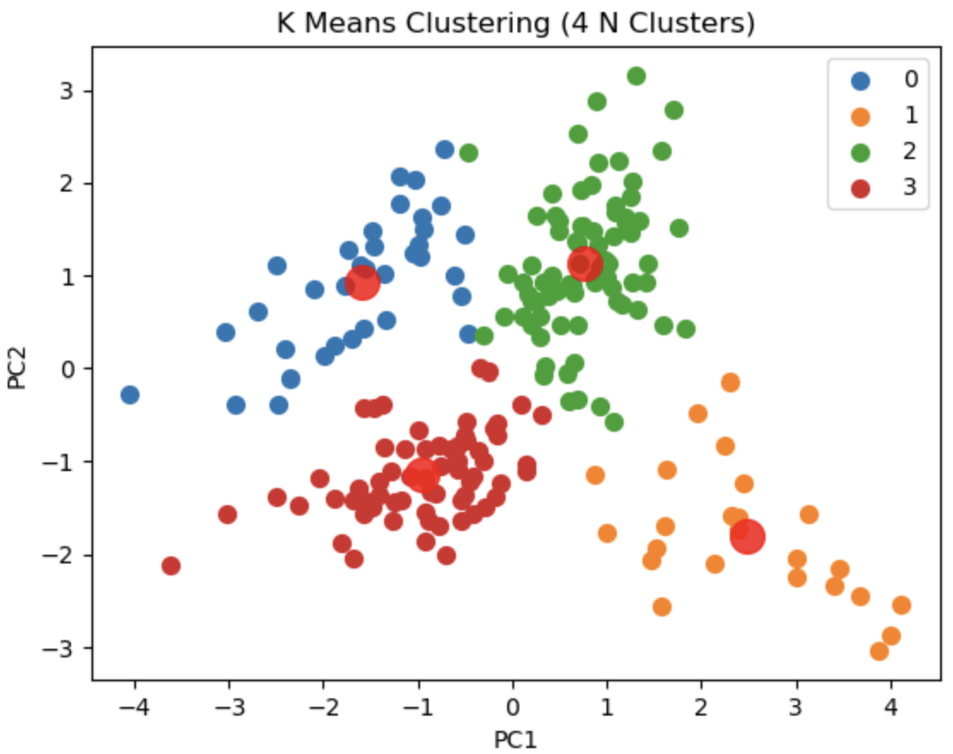
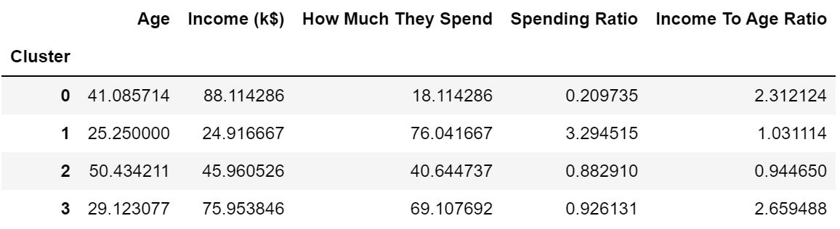
Final Model: K Means Clustering (After Hyperparameter Tuning)
For my final model, I decided to choose K-Means Clustering as
It has the highest silhouette coefficient of 0.505
It has the lowest Davies Bouldin Score of 0.701
K-Means is easy to implement and interpret.
Interpretation of Clusters:
Cluster 0: Middle-Aged Citizens and High Income. These customers have a low spending ratio despite having a high income. They are financially stable and knows how to budget well. Cluster 1: Young And Undisciplined Customers. Despite, these customers having a low income, they are big spenders and have the highest spending ratio. Cluster 2: Senior Citizens. These customer have moderate spending and have average income. Cluster 3: Young and High-Income Customers. These customers are from the above average income group and have a high spending

Slide 10
Conclusion
Cluster 0 and 3 from the K-Means Algorithm are the most valuable segment to the shopping mall. Cluster 0 holds a group of middle-aged customers with high income but not spending much. Cluster 3 holds customers with high income and have high spending. Recommendations: 1. The shopping mall can induce Cluster 0 to spend more by targeting advertisements and loyalty programs that offer discounts to attract them to frequently shop in the mall. 2. As for Cluster 3, these customers have high spending habits. The mall can gather customer feedbacks to enhance the shopping experience and create a special Membership for these customers in Cluster 3 for benefits such as discounts
This customer segmentation journey has been very fruitful, I have learned more in depth about how I can apply unsupervised learning to real world applications.

